Slide 1
Image Retrieval
Madhurima Chakraborty(19MCA0087)
Under the guidance of : Prof. M. Varalakshmi

Slide 2
01
Intuition
Contents
02
Objective
03
Related Works
04
Methodology
04
05
Results
06
Precision
07
Conclusion

Slide 3
Intuition

Slide 4

Content -Based
Image Retrieval
This methodology assists the user in searching for similar desired images for the given query from a vast database.

Slide 5
Objective

Slide 6
Objective
Our aim is to study the CNN approach for CBIR. Convolution Neural Networks are capable of successfully capturing high-level features of an image. The CNN model trains on a vast image dataset. The similarity between the two images is determined by using KNN between the feature vector of stored images and the query image. In this study, Convolution Neural Network uses auto-encoders to derive the features of image and store in the database.
60%

Slide 7
Related Works

Slide 8
Related Works
PAPER
YEAR
CONTENT
Content based image retrieval using deep learning process | 2019 | This approach retrieves results from a vast collection of images, depending on the image characteristics. The authors have exercised deep learning to extract various image features.
Differential Learning: A Powerful Tool for Interactive Content-Based Image Retrieval | 2019 | This work focuses on simplifying the image retrieval process using deep learning. The approach adopts the gravitational field model to construct the image-matching dataset.
Content-based image retrieval system with most relevant features among wavelet and color features | 2019 | Rashno has studied the low-frequency components. Based on those components, the author has proposed a novel technique for extracting features. Texture and color are the subjects of study in this paper.
A Novel Technique for Effective Image Gallery Search using Content Based Image Retrieval System | 2019 | The research sheds light on how a Content-Based Image retrieval system would help in searching and managing the relevant images. Fast retrieval of search results is also a concern, given that the amount of data is enormous

Slide 9
Related Works
PAPER
YEAR
CONTENT
A content-based parallel image retrieval system. | 2019 | They have applied the browser/server approach for faster retrieval of result queries.
Content Based Image Retrieval Using Multi-Sequential Search | 2018 | researchers have introduced a multi-level sequential methodology for analyzing the image. They have used one characteristic at a time and examined them.
Multi-stage image retrieval based on feature augmentation with truncated polynomial weight | 2018 | has used the Google Landmarks Dataset to work on faster query retrieval. They have used iterative-query-expansion and multi-stage-retrieval. This approach allows them to provide more accurate results for the queries.
Visual Entity Identification Using Content Based Image Retrieval Technique | 2018 | authors have used the widely-used HSV Histogram method and calculated color moments. The hue-saturation-value histogram describes the color component. While many proximity measures like Manhatten distance, Euclidean distance, etc. can be used. This visual entity approach has resulted in significant results

Slide 10
Methodology

Slide 11
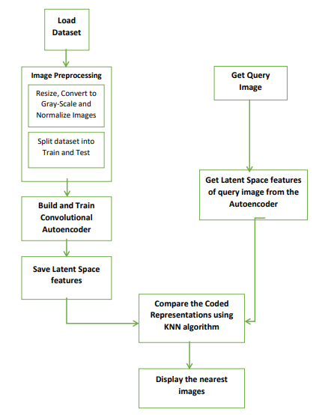
Content Based Image Retrieval
Content Based Image Retrieval
The proposed method here is to use Convolution Neural Network based Autoencoder, to extricate high-level features from the images. The characteristics thus extracted, is known as feature-vector. For retrieval purposes, KNN algorithm is used to compare the features of the query image and the features of stored images. The images with the least distances are the most similar images to the query image.

Slide 12
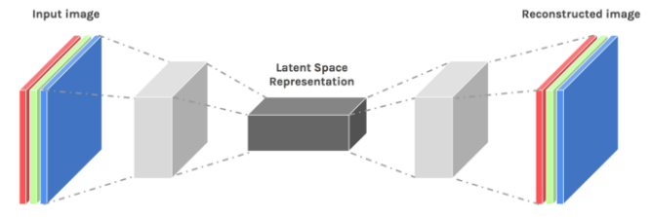
Block Diagram of the Autoencoder
The Autoencoder is built of Convolution Layer, followed by LeakyReLU Layer and a Batch Normalization Layer.

Slide 13
Results

Slide 14
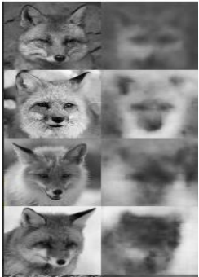
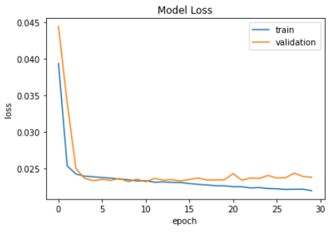
Content Based Image Retrieval
Training the Autoencoder
The Autoencoder is trained over 30 epochs using the ADAM optimizer. Learning rate of the optimizer is set at 0.001 , with loss function as ‘Mean Squared Error’.
After training, the loss was reduced to 2% approximately.
From the Loss vs Epoch graph, we can conclude the model is successful in learning the latent features and fits the model properly.

Slide 15
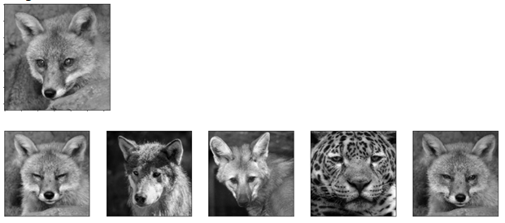
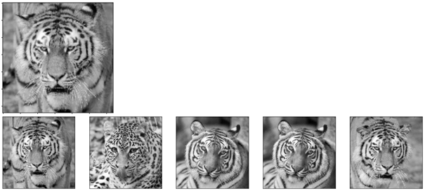
Content Based Image Retrieval
Image Retrieval using KNN
Using the KNN algorithms, 5 nearest images are retrieved for each test image in the dataset.
The precision of the images retrieved vary from 20% to 100%

Slide 16
Precision

Slide 17

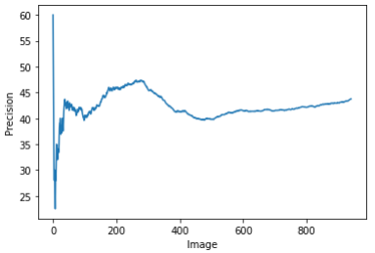
Content Based Image Retrieval
Precision
Precision for each test image is calculated to define the number of correct retrievals. The mathematical representation for precision is shown alongside.
To find the performance accuracy of the entire model, mean precision of the test dataset is calculated. The mean precision has turned out to be 43% approximately.

Slide 18
Conclusion

Slide 19
Conclusion
In this project , we aim to build a content-based image retrieval system. The Convolution Neural Network using autoencoders have provided good results, as the reconstructed image are quite better than the original input images. This proves that, the autoencoders are successful in extricating the high-level features of the query image and dataset images. Further, the KNN algorithm is successful in retrieving similar images to the query image. The autoencoder model is able to achieve 43% accuracy overall.
60%

Slide 20
THANK YOU

